Slide 1

EDS ACTIVITY
NAME :- BHUSHAN YOGESH BHAMARE
ROLL :- CS7-69
PRN :- 202401110078
RESOURCES :-

Slide 2




mail data
File Edit
Â œ ,îïs
View Insert
Format
- t ä
Data
Tools
•* •*
Extensions Help
123 Defaul...
@ W c:t @›
1009s
- 10 -F B 7
A1
/x Category
A
D
*
Category
Message
Go unäl jurong point, crazy.. Available only in bugis n great world la e buffet... Cine there got amore wat.. Ok lar... Joking wif u oni.
2
3
4
ham ham spam ham
< ham spam ham
ham spam
spam ham spam spam ham ham
spam ham ham ham spam
Free entry in 2 a wldy comp to wki FA Cup final tkts 21st May 2005. Text FA to 87121 to receive entry ques4on(std txt rate)T&C’s apply 08452810075over18’!
U dun say so early hor.. U c already then say...
Nah I don't think he goes to usf, he lives around here though
FreeMsg Hey there darling "rt's been 3 week's now and no word back! I'd like some fun you up for it still? Tb ok! XxX std chgs to send, £1.50 to rev Even my brother is not like to speak with me. They treat me like aids patent.
As per your request 'Melle Melle (Oru Mkinaminunginte Nurungu Vettam)' has been set as your callertune for all Callers. Press “9 to copy your friends Callert WINNER!! As a valued network customer you have been selected to receivea £900 prize reward! To daim call 09061701461. Claim code KL341. Valid 12 hoc
Had your mobile 11 months or more? U R enätled to Update to the latest colour mobiles with camera for Free! Call The Mobile Update Co FREE on 0800298 l'm gonna be home soon and i don't want to talk about this stuff anymore tonight, k? l've cried enough today.
SIX chances to win CASH! From 100 to 20,000 pounds txt> CSH11 and send to 87575. Cost 150p/day, 6days, 16+ TsandCs apply Reply HL 4 info URGENT! You have won a 1 week FREE membership in our £100,000 Prize Jackpoti Txt the word: CLAIM to No: 81010 T&C www.dbuk.net LCCLTD POBO l've been searching for the right words to thank you for this breather. I promise i wont take your help for granted and will fuGI my promise. You have been wow I HAVE A DATE ON SUNDAY WITH WILL!!
10
11
12
13
14
15
16
XXXMobileMovieClub: To use your credit, click the WAP link in the next txt message or click here>» http://wap. xxxmobilemovieclub.com?n=QJKGIGHJJGCI
Oh k...Fm watching here:)
Eh u remember how 2 spell his name... Yes i did. Ne v naughty make until i v wet. Fée if thatCls the way u feel. ThatZs the way ’its gota b
Enqland v Macedonia - dont miss the aoals/team news. Txt ur national team to 87077 eq ENGLAND to 87077 TrY:WALES. SCOTLAND 4txt/ù1.20 POBOXo›
20
21

Slide 3
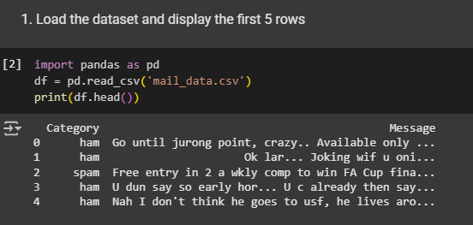

Slide 4
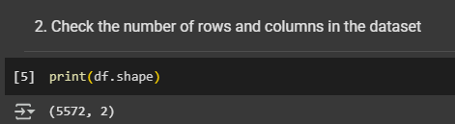
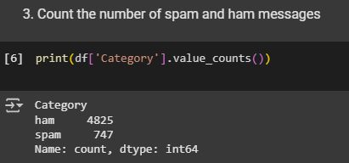

Slide 5
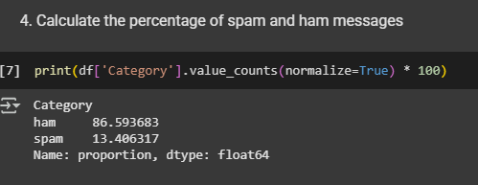

Slide 6
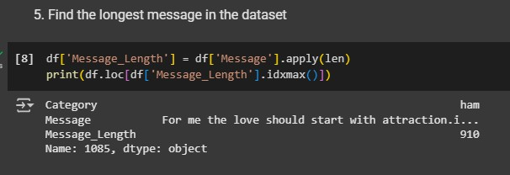

Slide 7
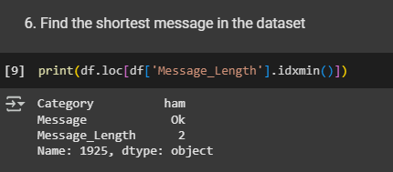

Slide 8
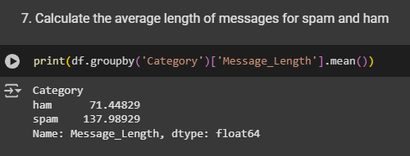

Slide 9
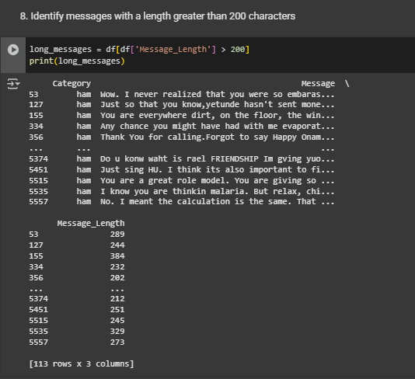

Slide 10
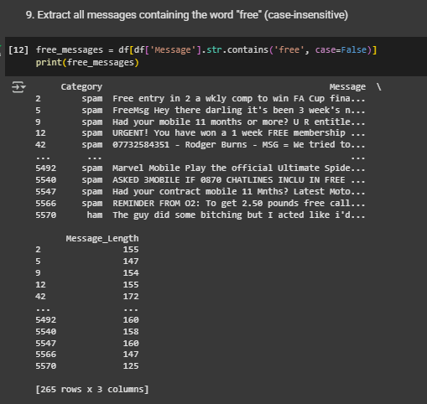

Slide 11
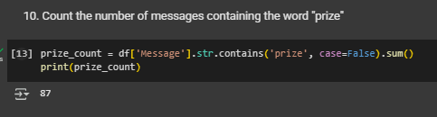
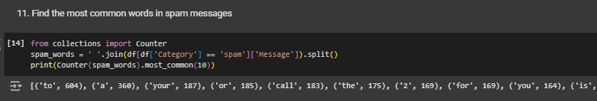

Slide 12
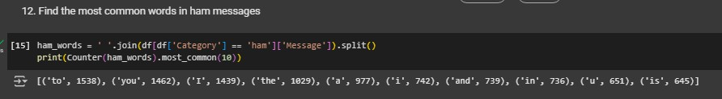
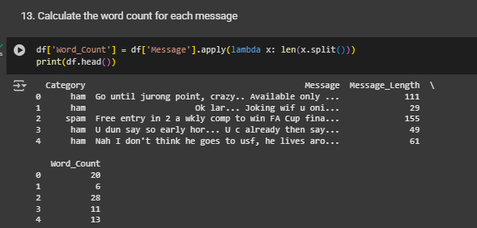

Slide 13
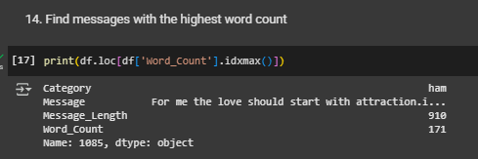

Slide 14
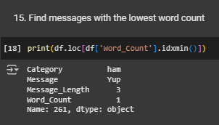

Slide 15
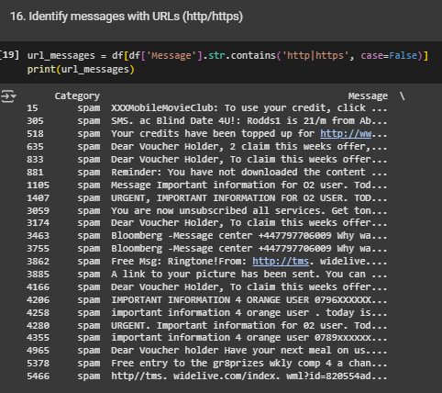
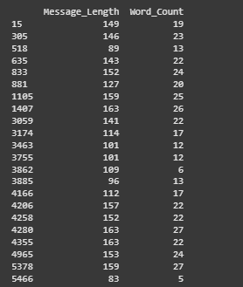

Slide 16
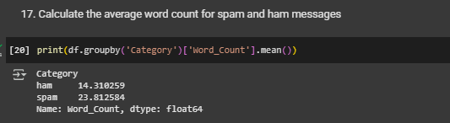

Slide 17
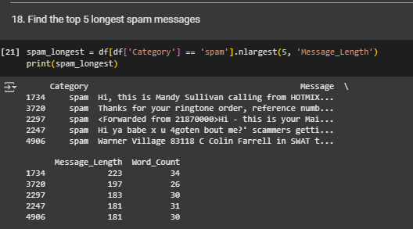

Slide 18
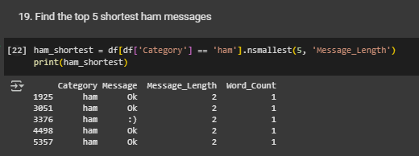

Slide 19
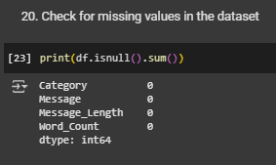

Slide 20
THANKS YOU

